Slide 1

Deriving global reference concentrations of water quality contaminants
Richard McDowell
Martin Upsdell
Peter Pletnyakov
Dongwen Luo
November 2023
Notes:
Thanks, Alasdair Noble
, here I would like to present the process for deriving global reference concentrations of water quality contamination. This work was done by my colleagues Richard McDowell, Martin Upsdell
Peter Pletnyakov and me from AgResearch.

Slide 2
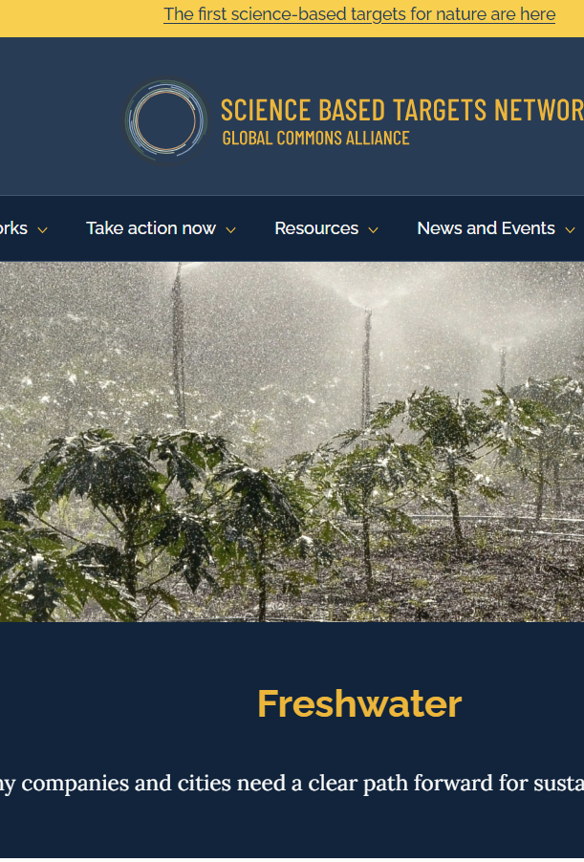
Motivation
Water stands as a fundamental necessity for all human life. However, mounting consumption, climate change, and pollution are exerting significant pressures on water supply systems.
The Science Based Targets Network provides guidance to global companies and cites to benchmark their footprint, including reference concentrations of water quality contaminants contributed by this study. (https://sciencebasedtargetsnetwork.org/our-mission/issue-hubs/water/)
Notes:
The motivation of this work due to water stands a fundamental necessary of all human life, but mounting consumption, climate change and pollution cause a significant pressures on water supply systems. In the website of The Science Based Targets Network provides guidance to global companies and cities to benchmark their footprint, including reference concentration of water quality contaminants which are contributed by our work. This website offers the first science-based targets for nature.

Slide 3
AIM
The presence of nitrogen (N) and phosphorus (P) in rivers can stimulate eutrophication. To effectively manage eutrophication, many regulatory bodies and jurisdictions rely on the concept of reference conditions.
These reference conditions typically denote the concentration or yield of N and P in rivers when there is no significant human influence or disturbance.
This study derives reference concentrations for dissolved reactive P (DRP), nitrate-nitrogen (NO3N), total P (TP), and total N (TN).
Notes:
There are four analytes we would like to obtain their reference concentrations Dissolved reactive P DRP, Nitrate-nitrogen NO3N, Total P and Total N

Slide 4
Estimate methods
Minimally disturbed condition (MDC) sets reference conditions based on rivers with minimal human disturbance, like less than 5% agricultural land use. However, finding such sites is rare, especially in regions with a long history of agriculture, thus MDC might only represent a few areas.
Least disturbed condition (LDC) groups sample data, setting a reference condition at a lower percentile (e.g., 5th percentile) of the data distribution. However, this approach carries the risk of setting the reference condition too high.
Approach used in this study applies stochastic models that combine water quality with human influence, and catchment characteristics to estimate reference conditions. Comparing with the above techniques, these methods leverage a larger pool of data, producing outputs that are less biased and more representative of local situation.
Notes:
The simplest way to estimate reference conditions is called minimum disturbed condition (MDC)

Slide 5

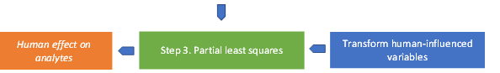
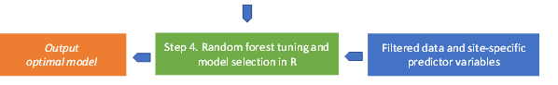

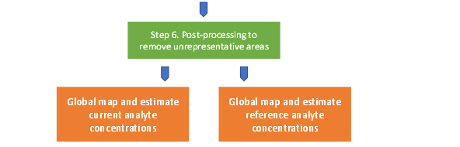
deriving Process
Notes:
There are several steps in the deriving process, step 1 and 2 are data inspection and correction which mainly done by Richard and Martin. Step3 transforms several human influenced variables to one human effect index using PLS. Step4 built and optimized random forest model using R for filtered data and site-specific predictors. Step5 implies the optimal model in GIS via Python, then produces global map for current and reference concentration for DRP and NO3N. The work from step3 to 5 was done by me, and Peter finalized the last step.

Slide 6
Data
Analyte | Observations | Catchments | Time Period
Dissolved Reactive P | 78,896 | 2,202 | 2005-2012
Nitrate-Nitrogen | 87,662 | 2,189 | 2005-2012
Total P | 108,188 | 2,438 | 2005-2012
Total N | 308,092 | 1,007 | 2005-2012
Data was collected from published papers and global databases (such as JAWRA, Global River Data Centre etc.)
All empirical data that support the main findings of this study have been deposited in Figshare (https://figshare.com/s/b51c203d572026b7ee28)
Notes:
Data was collected from published papers and global databases (such as JAWRA, Global River Data Centre etc.)
In the data we have 4 analytes, there are several thousand of catchments for each analyte, at each catchment there are various number of observations, then the value at each catchment will be the mean or median of the associated observations. The number of observations plays a role of weight in the modelling.
We chose data from 2005-2012 due to data quality consistency and try to avoid variation associated with continental or global climatic trends.

Slide 7
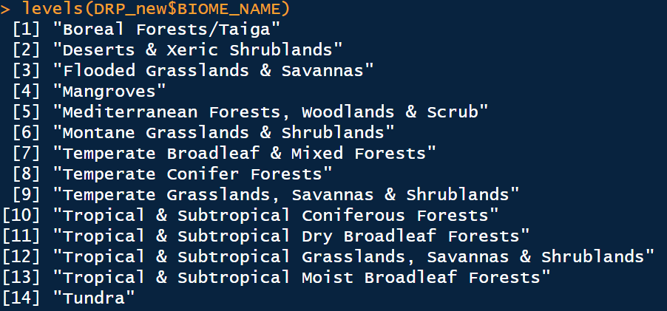
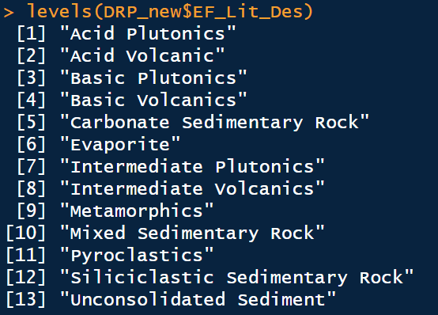

Variables
Variable (years of data used) | Units | Source
Human influence variables
Crop cover (crop) | % of catchment | ¹
Forest cover (forest) | % of catchment | ¹
Lentic cover (lentic) | % of catchment | ¹
Pasture cover (pasture) | % of catchment | ¹
Rangeland cover (range_land) | % of catchment | ¹
Urban cover (urban) | % of catchment | ¹
Soil Olsen P stock (OlsenP) | kg ha⁻¹ | ²
Population density (PopDens) | Number of people km⁻² | ³
Catchment characteristics considered in final models
Human effect (Human) | dimensionless | from above
Number of observations at each site (NObs) | - | -
Mean altitude (Mean_Altitude) | m above sea level | ⁴
Mean slope (Mean_Slope) | % | ⁴
Soil order (S_order) | % of catchment | ⁵
GDP per capita (GDP) | USD person⁻¹ | ⁶
Latitude (Latitude) | Degrees | ⁷
Catchment area (Area_SqKm) | km² | ⁴
Mean evapotranspiration (ET) | mm yr⁻¹ | ⁸
Mean potential evapotranspiration (ETpot) | mm yr⁻¹ | ⁸
Soil wetness (Soil_wet) | mm over profile | ⁸
Mean runoff by month (1-12) (runoff_n) | mm | ⁹
Mean rainfall (rainfall_n) | mm yr⁻¹ | ¹⁰
Mean precipitation by month (1-12) (precip_n) | mm | ¹⁰
Ecoregion within biomes (ECO_NAME) | Categorical | ¹¹
Global ecological land units – Bioclimate (EF_Bio_Des) | Categorical | ¹²
Global ecological land units – landform (EF_LF_Desc) | Categorical | ¹²
Global ecological land units – lithology (EF_Lit_Des) | Categorical | ¹²
Terrestrial biomes (BIOME_NAME) | Categorical | ¹¹

Slide 8
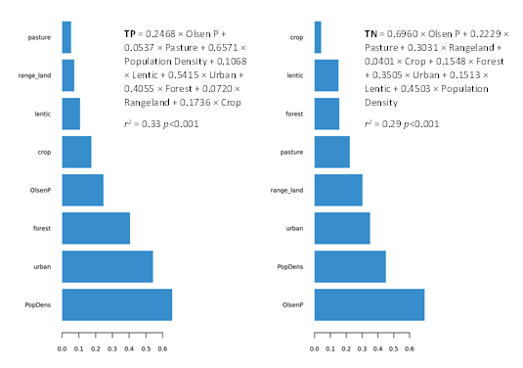
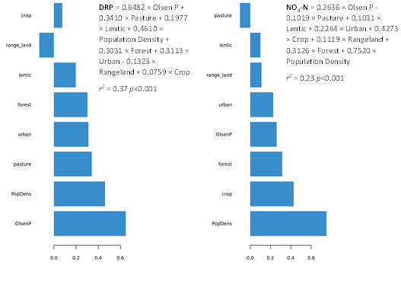
Deriving Human effects (PLS)
Shiny App at https://dataintegration.agr.nz/app/dataintegration

Slide 9
Random Forest
A random forest is a machine learning method used for both classification and regression tasks. It consists of decision trees, where each tree is built independently based on a random subset of the training data and features. The resulting "forest" is a collection of these individual decision trees.
Random forests offer several advantages, making them a popular choice in machine learning applications, such as High Accuracy, Robustness, Handles High-Dimensional Data, Reduced Overfitting, Works Well with Imbalanced Data, and Versatility.
Notes:
Linear Regression:, Ridge and Lasso Regression, Fradient Forest Regression, SVR, KNN

Slide 10
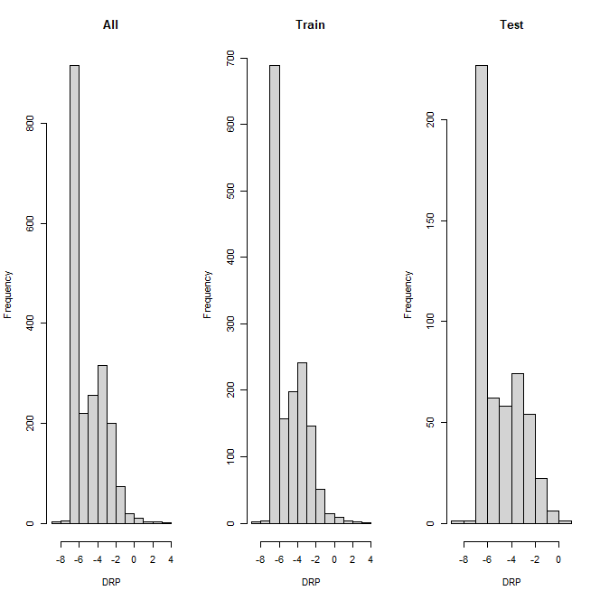
Data Split
Parameter | Count | Mean | Median | Std Error | 25th percentile | 75th percentile | Min | Max
DRP all | 2022 | -5.167 | -5.307 | 0.042 | -6.908 | -3.685 | -8.080 | 3.726
DRP train | 1516 | -5.164 | -5.307 | 0.048 | -6.908 | -3.685 | -8.080 | 3.726
DRP test | 506 | -5.176 | -5.307 | 0.082 | -6.908 | -3.685 | -8.080 | 0.642
NO₃-N all | 2189 | -1.492 | -1.427 | 0.032 | -2.408 | -0.511 | -6.475 | 3.059
NO₃-N train | 1641 | -1.488 | -1.427 | 0.038 | -2.408 | -0.511 | -6.475 | 2.708
NO₃-N test | 548 | -1.503 | -1.427 | 0.064 | -2.408 | -0.511 | -6.475 | 3.059
TP all | 2438 | -2.822 | -2.781 | 0.032 | -3.905 | -1.833 | -9.284 | 2.196
TP train | 1827 | -2.825 | -2.781 | 0.036 | -3.905 | -1.833 | -9.284 | 2.196
TP test | 611 | -2.814 | -2.786 | 0.064 | -3.905 | -1.833 | -5.809 | 1.435
TN all | 1007 | -0.820 | -0.674 | 0.045 | -2.038 | 0.095 | -4.605 | 3.090
TN train | 753 | -0.819 | -0.674 | 0.053 | -2.038 | 0.086 | -4.605 | 3.090
TN test | 254 | -0.824 | -0.673 | 0.088 | -2.022 | 0.095 | -4.605 | 2.198
Notes:
Slit into training and Testing by 75%, 25%, For regression purpose, we should ensure distribution of response will be similar among the All, Train and Test data sets.
The table summarized the number of observations of three data sets for each analytes, and seven statistics summary for

Slide 11
Finding the best model in R
Training data:
Tuning Hyper-parameters (grid search)
– Number of trees,
– Number of variables to possibly split at in each node,
– Minimal node size.
Feature selection (10-fold cross validation) f variables to possibly split at in each node.
Testing data:
Checking effects of the optimal model
Performance metric (MAE, RMSE, R2)

Slide 12
Model | i | j | K | Terms | MAE | RMSE | R2 | Model terms for DRP
1 | 100 | 16 | 4 | 25 | 0.750 | 1.103 | 0.815 | Latitude + Runoff_1 + Runoff_2 + Runoff_3 + Runoff_4 + Runoff_5 + Runoff_6 + Runoff_7 + Runoff_8 + Runoff_9 + Runoff_10 + Runoff_11 + Runoff_12 + Area_SqKm + Mean_Slope + S_Order + LC + BIOME_NAME + EF_Lit_Des + ET + ETPot + SoilWet + Bio_temp + Bio_Moist + human_effect
2 | 500 | 19 | 1 | 24 | 0.751 | 1.110 | 0.812 | EF_Lit_Des + LC + Runoff_8 + Runoff_7 + Runoff_10 + S_Order + Runoff_4 + Runoff_9 + Runoff_12 + Runoff_1 + Runoff_11 + SoilWet + Runoff_2 + Runoff_6 + Area_SqKm + Runoff_5 + Bio_temp + Runoff_3 + ET + ETPot + Mean_Slope + Latitude + BIOME_NAME + human_effect
3 | 300 | 13 | 1 | 23 | 0.749 | 1.104 | 0.815 | LC + Runoff_8 + Runoff_7 + Runoff_10 + Runoff_4 + Runoff_9 + S_Order + Runoff_1 + Runoff_11 + Runoff_12 + SoilWet + Runoff_2 + Bio_temp + Runoff_3 + Runoff_6 + Runoff_5 + Area_SqKm + ETPot + ET + Mean_Slope + Latitude + BIOME_NAME + human_effect
4 | 300 | 13 | 3 | 22 | 0.749 | 1.104 | 0.814 | Runoff_8 + Runoff_7 + Runoff_10 + S_Order + Runoff_4 + Runoff_9 + Runoff_1 + SoilWet + Runoff_11 + Runoff_12 + Runoff_6 + Runoff_5 + Area_SqKm + Bio_temp + Runoff_2 + Runoff_3 + ETPot + ET + Mean_Slope + Latitude + BIOME_NAME + human_effect
5 | 500 | 13 | 1 | 21 | 0.750 | 1.106 | 0.813 | Runoff_7 + Runoff_10 + Runoff_4 + S_Order + Runoff_9 + Runoff_1 + SoilWet + Runoff_12 + Runoff_11 + Runoff_6 + Runoff_5 + Runoff_2 + Area_SqKm + Bio_temp + Runoff_3 + ETPot + ET + Mean_Slope + Latitude + BIOME_NAME + human_effect
6 | 300 | 13 | 1 | 20 | 0.748 | 1.104 | 0.814 | Runoff_4 + Runoff_7 + Runoff_1 + S_Order + Runoff_9 + Runoff_12 + SoilWet + Runoff_11 + Runoff_2 + Runoff_6 + Bio_temp + Runoff_3 + Runoff_5 + Area_SqKm + ETPot + ET + Mean_Slope + Latitude + BIOME_NAME + human_effect
7 | 300 | 13 | 3 | 19 | 0.746 | 1.101 | 0.815 | Runoff_7 + S_Order + Runoff_1 + Runoff_11 + Runoff_12 + SoilWet + Runoff_9 + Bio_temp + Runoff_6 + Runoff_2 + Runoff_5 + Area_SqKm + Runoff_3 + ET + ETPot + Mean_Slope + Latitude + BIOME_NAME + human_effect
8 | 500 | 13 | 1 | 18 | 0.744 | 1.103 | 0.814 | S_Order + Runoff_1 + Runoff_12 + Runoff_11 + Runoff_9 + Bio_temp + SoilWet + Runoff_2 + Area_SqKm + Runoff_6 + Runoff_5 + Runoff_3 + ETPot + ET + Mean_Slope + Latitude + BIOME_NAME + human_effect
9 | 300 | 11 | 3 | 17 | 0.742 | 1.100 | 0.815 | Runoff_1 + SoilWet + Runoff_12 + Runoff_11 + Runoff_9 + Bio_temp + Runoff_2 + Runoff_5 + Runoff_6 + Area_SqKm + Runoff_3 + ETPot + ET + Mean_Slope + Latitude + BIOME_NAME + human_effect
10 | 900 | 9 | 1 | 16 | 0.744 | 1.097 | 0.817 | Runoff_12 + SoilWet + Runoff_11 + Runoff_9 + Runoff_2 + Area_SqKm + Bio_temp + Runoff_6 + Runoff_5 + Runoff_3 + ETPot + ET + Mean_Slope + Latitude + BIOME_NAME + human_effect
11 | 300 | 9 | 1 | 15 | 0.741 | 1.097 | 0.816 | SoilWet + Runoff_9 + Runoff_12 + Bio_temp + Area_SqKm + Runoff_5 + Runoff_2 + Runoff_6 + Runoff_3 + ETPot + Mean_Slope + ET + Latitude + BIOME_NAME + human_effect
12 | 100 | 7 | 4 | 14 | 0.740 | 1.093 | 0.818 | Bio_temp + Runoff_9 + Runoff_12 + Area_SqKm + Runoff_6 + Runoff_3 + Runoff_2 + Runoff_5 + ETPot + ET + Mean_Slope + Latitude + BIOME_NAME + human_effect
13 | 700 | 7 | 1 | 13 | 0.749 | 1.105 | 0.813 | Runoff_9 + Runoff_5 + Area_SqKm + Runoff_6 + Runoff_12 + Runoff_2 + Runoff_3 + ETPot + Mean_Slope + ET + Latitude + BIOME_NAME + human_effect
14 | 900 | 7 | 2 | 12 | 0.751 | 1.108 | 0.812 | Area_SqKm + Runoff_12 + Runoff_6 + Runoff_5 + Runoff_2 + Runoff_3 + Mean_Slope + ETPot + ET + Latitude + BIOME_NAME + human_effect
15 | 900 | 6 | 2 | 11 | 0.752 | 1.106 | 0.813 | Runoff_5 + Runoff_12 + Runoff_2 + Runoff_6 + Runoff_3 + Mean_Slope + ET + ETPot + Latitude + BIOME_NAME + human_effect
16 | 700 | 5 | 2 | 10 | 0.754 | 1.106 | 0.813 | Runoff_5 + Runoff_6 + Runoff_2 + Runoff_3 + Mean_Slope + ET + ETPot + Latitude + BIOME_NAME + human_effect
17 | 500 | 4 | 2 | 9 | 0.752 | 1.101 | 0.815 | Runoff_6 + Runoff_2 + Runoff_3 + Mean_Slope + ETPot + ET + Latitude + BIOME_NAME + human_effect
18 | 500 | 3 | 1 | 8 | 0.754 | 1.099 | 0.816 | Runoff_6 + Runoff_3 + Mean_Slope + ET + ETPot + Latitude + BIOME_NAME + human_effect
19 | 500 | 3 | 1 | 7 | 0.752 | 1.098 | 0.816 | Mean_Slope + Runoff_3 + ETPot + ET + Latitude + BIOME_NAME + human_effect
20 | 900 | 3 | 2 | 6 | 0.750 | 1.098 | 0.815 | Runoff_3 + ET + ETPot + Latitude + BIOME_NAME + human_effect
21 | 900 | 3 | 2 | 5 | 0.769 | 1.124 | 0.806 | ET + ETPot + Latitude + BIOME_NAME + human_effect
22 | 500 | 2 | 1 | 4 | 0.783 | 1.145 | 0.798 | ETPot + Latitude + BIOME_NAME + human_effect
23 | 300 | 3 | 2 | 3 | 0.788 | 1.201 | 0.773 | Latitude + BIOME_NAME + human_effect

Slide 13
Model | i | j | k | Terms | MAE | RMSE | R2 | Model terms for NO3-N
1 | 500 | 7 | 4 | 25 | 0.728 | 0.991 | 0.762 | Latitude + Runoff_1 + Runoff_2 + Runoff_3 + Runoff_4 + Runoff_5 + Runoff_6 + Runoff_7 + Runoff_8 + Runoff_9 + Runoff_10 + Runoff_11 + Runoff_12 + Area_SqKm + Mean_Slope + S_Order + LC + BIOME_NAME + EF_Lit_Des + ET + ETPot + SoilWet + Bio_temp + Bio_Moist + human_effect
2 | 700 | 7 | 1 | 24 | 0.729 | 0.991 | 0.761 | EF_Lit_Des + Runoff_5 + Bio_temp + Runoff_3 + Runoff_6 + Runoff_2 + Runoff_7 + Runoff_4 + Runoff_10 + S_Order + Runoff_8 + Mean_Slope + Runoff_9 + Runoff_1 + SoilWet + Runoff_12 + Area_SqKm + ETPot + ET + LC + Runoff_11 + Latitude + BIOME_NAME + human_effect
3 | 500 | 7 | 3 | 23 | 0.728 | 0.989 | 0.762 | Runoff_5 + Runoff_3 + Bio_temp + Runoff_7 + Runoff_6 + Runoff_4 + Runoff_2 + Runoff_10 + S_Order + Runoff_8 + Runoff_9 + Mean_Slope + SoilWet + Runoff_1 + Area_SqKm + Runoff_12 + ETPot + ET + LC + Runoff_11 + Latitude + BIOME_NAME + human_effect
4 | 300 | 7 | 1 | 22 | 0.728 | 0.990 | 0.762 | Runoff_3 + Runoff_6 + Runoff_7 + Runoff_4 + Runoff_2 + Bio_temp + Runoff_10 + S_Order + Runoff_8 + Runoff_1 + Mean_Slope + Runoff_9 + SoilWet + Runoff_12 + Area_SqKm + ETPot + ET + LC + Runoff_11 + Latitude + BIOME_NAME + human_effect
5 | 500 | 7 | 1 | 21 | 0.729 | 0.991 | 0.761 | Runoff_3 + Runoff_6 + Runoff_7 + Runoff_2 + Runoff_4 + Runoff_10 + Runoff_8 + S_Order + Runoff_1 + SoilWet + Runoff_9 + Mean_Slope + Runoff_12 + Area_SqKm + ETPot + LC + ET + Runoff_11 + Latitude + BIOME_NAME + human_effect
6 | 500 | 7 | 1 | 20 | 0.728 | 0.991 | 0.761 | Runoff_6 + Runoff_7 + Runoff_2 + Runoff_4 + Runoff_10 + S_Order + Runoff_8 + Runoff_1 + Runoff_9 + Mean_Slope + SoilWet + Runoff_12 + Area_SqKm + ET + ETPot + LC + Runoff_11 + Latitude + BIOME_NAME + human_effect
7 | 300 | 7 | 1 | 19 | 0.729 | 0.991 | 0.761 | Runoff_6 + Runoff_10 + Runoff_2 + Runoff_4 + S_Order + Runoff_8 + Runoff_9 + Runoff_1 + Mean_Slope + SoilWet + Runoff_12 + Area_SqKm + ETPot + ET + LC + Runoff_11 + Latitude + BIOME_NAME + human_effect
8 | 500 | 5 | 3 | 18 | 0.727 | 0.987 | 0.764 | Runoff_6 + Runoff_2 + Runoff_4 + S_Order + Runoff_8 + Runoff_1 + Mean_Slope + Runoff_9 + SoilWet + Runoff_12 + Area_SqKm + ETPot + ET + LC + Runoff_11 + Latitude + BIOME_NAME + human_effect
9 | 700 | 5 | 1 | 17 | 0.727 | 0.988 | 0.763 | Runoff_2 + S_Order + Runoff_4 + Runoff_8 + Runoff_1 + Mean_Slope + Runoff_9 + SoilWet + Area_SqKm + Runoff_12 + ETPot + ET + LC + Runoff_11 + Latitude + BIOME_NAME + human_effect
10 | 700 | 5 | 1 | 16 | 0.727 | 0.987 | 0.764 | S_Order + Runoff_4 + Runoff_8 + Mean_Slope + Runoff_1 + Runoff_9 + SoilWet + Area_SqKm + Runoff_12 + ETPot + LC + ET + Runoff_11 + Latitude + BIOME_NAME + human_effect
11 | 300 | 5 | 1 | 15 | 0.733 | 0.995 | 0.759 | Runoff_4 + Runoff_8 + Mean_Slope + Runoff_1 + Runoff_9 + SoilWet + Area_SqKm + Runoff_12 + ETPot + ET + LC + Runoff_11 + Latitude + BIOME_NAME + human_effect
12 | 300 | 5 | 4 | 14 | 0.733 | 0.993 | 0.760 | Runoff_8 + Mean_Slope + Runoff_1 + SoilWet + Runoff_9 + Runoff_12 + Area_SqKm + ETPot + ET + LC + Runoff_11 + Latitude + BIOME_NAME + human_effect
13 | 300 | 5 | 1 | 13 | 0.732 | 0.994 | 0.759 | Mean_Slope + Runoff_1 + SoilWet + Runoff_9 + Runoff_12 + Area_SqKm + ETPot + ET + LC + Runoff_11 + Latitude + BIOME_NAME + human_effect
14 | 300 | 5 | 1 | 12 | 0.731 | 0.996 | 0.757 | Runoff_1 + SoilWet + Runoff_9 + Area_SqKm + Runoff_12 + ETPot + LC + ET + Runoff_11 + Latitude + BIOME_NAME + human_effect
15 | 500 | 3 | 1 | 11 | 0.731 | 0.992 | 0.761 | SoilWet + Runoff_12 + Runoff_9 + ETPot + Area_SqKm + LC + ET + Runoff_11 + Latitude + BIOME_NAME + human_effect
16 | 300 | 3 | 3 | 10 | 0.734 | 0.994 | 0.759 | Area_SqKm + Runoff_9 + Runoff_12 + ETPot + LC + ET + Runoff_11 + Latitude + BIOME_NAME + human_effect
17 | 500 | 2 | 2 | 9 | 0.743 | 1.000 | 0.755 | Runoff_9 + LC + Runoff_12 + ETPot + ET + Runoff_11 + Latitude + BIOME_NAME + human_effect
18 | 100 | 2 | 2 | 8 | 0.743 | 1.004 | 0.753 | LC + ETPot + Runoff_12 + ET + Runoff_11 + Latitude + BIOME_NAME + human_effect
19 | 900 | 2 | 1 | 7 | 0.745 | 1.008 | 0.750 | ETPot + Runoff_12 + ET + Runoff_11 + Latitude + BIOME_NAME + human_effect
20 | 900 | 2 | 3 | 6 | 0.746 | 1.008 | 0.750 | ETPot + ET + Runoff_11 + Latitude + BIOME_NAME + human_effect
21 | 500 | 2 | 1 | 5 | 0.745 | 1.012 | 0.748 | ET + Runoff_11 + Latitude + BIOME_NAME + human_effect
22 | 500 | 2 | 2 | 4 | 0.757 | 1.017 | 0.744 | ET + Latitude + BIOME_NAME + human_effect
23 | 700 | 2 | 2 | 3 | 0.806 | 1.080 | 0.707 | Latitude + BIOME_NAME + human_effect

Slide 14
Model | i | j | k | Terms | MAE | RMSE | R2 | Model terms for TP
1 | 300 | 16 | 4 | 25 | 0.728 | 1.015 | 0.759 | Latitude + Runoff_1 + Runoff_2 + Runoff_3 + Runoff_4 + Runoff_5 + Runoff_6 + Runoff_7 + Runoff_8 + Runoff_9 + Runoff_10 + Runoff_11 + Runoff_12 + Area_SqKm + Mean_Slope + S_Order + LC + BIOME_NAME + EF_Lit_Des + ET + ETPot + SoilWet + Bio_temp + Bio_Moist + human_effect
2 | 500 | 16 | 1 | 24 | 0.728 | 1.017 | 0.758 | Runoff_6 + Runoff_1 + Runoff_10 + LC + S_Order + EF_Lit_Des + Runoff_8 + Runoff_4 + Runoff_11 + Runoff_3 + Runoff_2 + SoilWet + Runoff_12 + Runoff_7 + ET + Runoff_9 + Bio_temp + Mean_Slope + Area_SqKm + Runoff_5 + ETPot + Latitude + BIOME_NAME + human_effect
3 | 500 | 16 | 3 | 23 | 0.728 | 1.014 | 0.759 | LC + Runoff_10 + Runoff_1 + S_Order + EF_Lit_Des + Runoff_4 + Runoff_8 + Runoff_3 + Runoff_11 + Runoff_2 + SoilWet + Runoff_12 + ET + Runoff_7 + Runoff_9 + Mean_Slope + Bio_temp + Area_SqKm + Runoff_5 + ETPot + Latitude + BIOME_NAME + human_effect
4 | 300 | 13 | 3 | 22 | 0.728 | 1.016 | 0.758 | LC + Runoff_1 + S_Order + Runoff_4 + EF_Lit_Des + Runoff_8 + Runoff_11 + Runoff_3 + Runoff_2 + Runoff_12 + SoilWet + ET + Runoff_7 + Runoff_9 + Mean_Slope + Bio_temp + Area_SqKm + Runoff_5 + ETPot + Latitude + BIOME_NAME + human_effect
5 | 300 | 10 | 3 | 21 | 0.725 | 1.011 | 0.761 | Runoff_1 + S_Order + EF_Lit_Des + Runoff_8 + Runoff_4 + Runoff_2 + Runoff_11 + Runoff_12 + Runoff_3 + SoilWet + ET + Runoff_9 + Mean_Slope + Runoff_7 + Bio_temp + Area_SqKm + Runoff_5 + ETPot + Latitude + BIOME_NAME + human_effect
6 | 900 | 13 | 3 | 20 | 0.731 | 1.020 | 0.756 | Runoff_1 + S_Order + Runoff_11 + Runoff_4 + Runoff_8 + Runoff_12 + Runoff_3 + Runoff_2 + SoilWet + Runoff_9 + ET + Runoff_7 + Mean_Slope + Runoff_5 + Area_SqKm + Bio_temp + ETPot + Latitude + BIOME_NAME + human_effect
7 | 900 | 13 | 1 | 19 | 0.731 | 1.019 | 0.756 | S_Order + Runoff_4 + Runoff_3 + Runoff_8 + Runoff_2 + Runoff_12 + Runoff_11 + SoilWet + ET + Runoff_7 + Runoff_9 + Bio_temp + Mean_Slope + Area_SqKm + Runoff_5 + ETPot + Latitude + BIOME_NAME + human_effect
8 | 300 | 13 | 1 | 18 | 0.732 | 1.022 | 0.755 | Runoff_4 + Runoff_8 + Runoff_3 + Runoff_2 + Runoff_11 + SoilWet + Runoff_12 + ET + Runoff_7 + Runoff_9 + Bio_temp + Mean_Slope + Area_SqKm + Runoff_5 + ETPot + Latitude + BIOME_NAME + human_effect
9 | 700 | 9 | 1 | 17 | 0.732 | 1.021 | 0.756 | Runoff_3 + Runoff_8 + Runoff_11 + SoilWet + Runoff_2 + Runoff_12 + ET + Runoff_7 + Bio_temp + Runoff_9 + Mean_Slope + Area_SqKm + Runoff_5 + ETPot + Latitude + BIOME_NAME + human_effect
10 | 700 | 11 | 1 | 16 | 0.732 | 1.022 | 0.755 | Runoff_11 + SoilWet + Runoff_12 + Runoff_2 + Runoff_3 + ET + Runoff_9 + Bio_temp + Runoff_7 + Mean_Slope + Area_SqKm + Runoff_5 + ETPot + Latitude + BIOME_NAME + human_effect
11 | 300 | 7 | 3 | 15 | 0.731 | 1.018 | 0.758 | Runoff_11 + Runoff_2 + SoilWet + Runoff_12 + ET + Bio_temp + Runoff_7 + Runoff_9 + Mean_Slope + Area_SqKm + Runoff_5 + ETPot + Latitude + BIOME_NAME + human_effect
12 | 500 | 9 | 2 | 14 | 0.731 | 1.020 | 0.756 | Runoff_12 + SoilWet + ET + Runoff_2 + Bio_temp + Runoff_9 + Mean_Slope + Area_SqKm + Runoff_7 + Runoff_5 + ETPot + Latitude + BIOME_NAME + human_effect
13 | 700 | 7 | 1 | 13 | 0.730 | 1.018 | 0.757 | ET + Runoff_12 + Runoff_2 + Bio_temp + Runoff_7 + Mean_Slope + Runoff_9 + Area_SqKm + Runoff_5 + ETPot + Latitude + BIOME_NAME + human_effect
14 | 300 | 5 | 2 | 12 | 0.728 | 1.015 | 0.759 | Runoff_2 + ET + Bio_temp + Mean_Slope + Runoff_9 + Area_SqKm + Runoff_7 + Runoff_5 + ETPot + Latitude + BIOME_NAME + human_effect
15 | 100 | 6 | 5 | 11 | 0.731 | 1.021 | 0.755 | Runoff_2 + ET + Mean_Slope + Runoff_9 + Area_SqKm + Runoff_7 + Runoff_5 + ETPot + Latitude + BIOME_NAME + human_effect
16 | 300 | 4 | 1 | 10 | 0.732 | 1.021 | 0.755 | Mean_Slope + ET + Area_SqKm + Runoff_9 + Runoff_7 + Runoff_5 + ETPot + Latitude + BIOME_NAME + human_effect
17 | 900 | 4 | 2 | 9 | 0.734 | 1.024 | 0.753 | Area_SqKm + Mean_Slope + Runoff_9 + Runoff_7 + Runoff_5 + ETPot + Latitude + BIOME_NAME + human_effect
18 | 300 | 3 | 1 | 8 | 0.737 | 1.023 | 0.754 | Area_SqKm + Runoff_9 + Runoff_7 + Runoff_5 + ETPot + Latitude + BIOME_NAME + human_effect
19 | 700 | 3 | 1 | 7 | 0.740 | 1.026 | 0.752 | Area_SqKm + Runoff_7 + Runoff_5 + ETPot + Latitude + BIOME_NAME + human_effect
20 | 700 | 3 | 2 | 6 | 0.745 | 1.032 | 0.748 | Runoff_5 + Runoff_7 + ETPot + Latitude + BIOME_NAME + human_effect
21 | 100 | 3 | 1 | 5 | 0.751 | 1.041 | 0.742 | Runoff_7 + ETPot + Latitude + BIOME_NAME + human_effect
22 | 300 | 2 | 3 | 4 | 0.771 | 1.057 | 0.733 | ETPot + Latitude + BIOME_NAME + human_effect
23 | 100 | 2 | 3 | 3 | 0.818 | 1.105 | 0.705 | Latitude + BIOME_NAME + human_effect

Slide 15
Model | i | j | k | Terms | MAE | RMSE | R2 | Model terms for TN
1 | 100 | 16 | 7 | 25 | 0.669 | 0.986 | 0.729 | Latitude + Runoff_1 + Runoff_2 + Runoff_3 + Runoff_4 + Runoff_5 + Runoff_6 + Runoff_7 + Runoff_8 + Runoff_9 + Runoff_10 + Runoff_11 + Runoff_12 + Area_SqKm + Mean_Slope + S_Order + LC + BIOME_NAME + EF_Lit_Des + ET + ETPot + SoilWet + Bio_temp + Bio_Moist + human_effect
2 | 100 | 13 | 7 | 24 | 0.672 | 0.993 | 0.725 | EF_Lit_Des + LC + Runoff_6 + Runoff_9 + S_Order + Runoff_10 + Runoff_12 + Runoff_8 + Bio_temp + Runoff_7 + Runoff_11 + SoilWet + Runoff_4 + Runoff_1 + Runoff_5 + ETPot + Mean_Slope + Area_SqKm + ET + Runoff_2 + Runoff_3 + Latitude + BIOME_NAME + human_effect
3 | 500 | 10 | 1 | 23 | 0.672 | 1.000 | 0.718 | LC + S_Order + Runoff_6 + Runoff_12 + Runoff_11 + Runoff_10 + Runoff_9 + Runoff_7 + Runoff_8 + SoilWet + Bio_temp + Runoff_1 + Runoff_5 + Mean_Slope + Runoff_4 + ETPot + Area_SqKm + ET + Runoff_2 + Runoff_3 + Latitude + BIOME_NAME + human_effect
4 | 300 | 13 | 3 | 22 | 0.672 | 0.997 | 0.720 | S_Order + Runoff_6 + Runoff_7 + Runoff_10 + Runoff_9 + Runoff_12 + Bio_temp + Runoff_8 + Runoff_11 + SoilWet + Runoff_1 + Runoff_5 + Mean_Slope + Area_SqKm + ETPot + ET + Runoff_4 + Runoff_2 + Runoff_3 + Latitude + BIOME_NAME + human_effect
5 | 700 | 7 | 3 | 21 | 0.672 | 0.992 | 0.724 | S_Order + Runoff_9 + Runoff_12 + Runoff_8 + Runoff_10 + Runoff_7 + Bio_temp + Runoff_11 + SoilWet + Runoff_5 + Runoff_1 + Runoff_4 + Mean_Slope + ETPot + ET + Area_SqKm + Runoff_2 + Runoff_3 + Latitude + BIOME_NAME + human_effect
6 | 300 | 10 | 3 | 20 | 0.672 | 0.995 | 0.721 | Runoff_12 + Runoff_10 + Runoff_9 + Bio_temp + Runoff_7 + Runoff_8 + Runoff_11 + Runoff_1 + SoilWet + Runoff_5 + Mean_Slope + Area_SqKm + ETPot + ET + Runoff_4 + Runoff_2 + Runoff_3 + Latitude + BIOME_NAME + human_effect
7 | 300 | 10 | 3 | 19 | 0.671 | 0.994 | 0.722 | Runoff_12 + Runoff_9 + Runoff_10 + Runoff_8 + Runoff_7 + Runoff_11 + SoilWet + Runoff_1 + Runoff_5 + Mean_Slope + Runoff_4 + Area_SqKm + ETPot + ET + Runoff_2 + Runoff_3 + Latitude + BIOME_NAME + human_effect
8 | 500 | 9 | 7 | 18 | 0.672 | 0.994 | 0.723 | Runoff_9 + Runoff_12 + Runoff_10 + Runoff_11 + Runoff_8 + SoilWet + Runoff_1 + Runoff_5 + Runoff_4 + Mean_Slope + Area_SqKm + ET + ETPot + Runoff_2 + Runoff_3 + Latitude + BIOME_NAME + human_effect
9 | 700 | 11 | 3 | 17 | 0.671 | 0.998 | 0.719 | Runoff_10 + Runoff_9 + Runoff_8 + Runoff_11 + SoilWet + Runoff_1 + Runoff_5 + Runoff_4 + Mean_Slope + Area_SqKm + ETPot + ET + Runoff_2 + Runoff_3 + Latitude + BIOME_NAME + human_effect
10 | 900 | 11 | 3 | 16 | 0.669 | 0.998 | 0.719 | Runoff_9 + Runoff_11 + Runoff_8 + SoilWet + Runoff_5 + Runoff_1 + Runoff_4 + Mean_Slope + ETPot + ET + Area_SqKm + Runoff_2 + Runoff_3 + Latitude + BIOME_NAME + human_effect
11 | 300 | 9 | 1 | 15 | 0.668 | 0.996 | 0.721 | Runoff_11 + Runoff_8 + SoilWet + Runoff_4 + Runoff_5 + Runoff_1 + Mean_Slope + ETPot + ET + Area_SqKm + Runoff_2 + Runoff_3 + Latitude + BIOME_NAME + human_effect
12 | 300 | 7 | 2 | 14 | 0.666 | 0.992 | 0.723 | Runoff_11 + Runoff_8 + Runoff_1 + Runoff_5 + Runoff_4 + Mean_Slope + ETPot + ET + Area_SqKm + Runoff_2 + Runoff_3 + Latitude + BIOME_NAME + human_effect
13 | 700 | 5 | 2 | 13 | 0.663 | 0.990 | 0.725 | Runoff_5 + Runoff_8 + Runoff_1 + Runoff_4 + Mean_Slope + Area_SqKm + ET + ETPot + Runoff_2 + Runoff_3 + Latitude + BIOME_NAME + human_effect
14 | 100 | 3 | 6 | 12 | 0.664 | 0.986 | 0.730 | Runoff_1 + Runoff_5 + Area_SqKm + Runoff_4 + Mean_Slope + ET + ETPot + Runoff_2 + Runoff_3 + Latitude + BIOME_NAME + human_effect
15 | 300 | 4 | 2 | 11 | 0.666 | 0.997 | 0.722 | Area_SqKm + Mean_Slope + ET + Runoff_4 + ETPot + Runoff_5 + Runoff_2 + Runoff_3 + Latitude + BIOME_NAME + human_effect
16 | 500 | 3 | 2 | 10 | 0.664 | 0.991 | 0.726 | Area_SqKm + Mean_Slope + ET + ETPot + Runoff_4 + Runoff_2 + Runoff_3 + Latitude + BIOME_NAME + human_effect
17 | 500 | 4 | 3 | 9 | 0.661 | 0.984 | 0.730 | Mean_Slope + ET + ETPot + Runoff_4 + Runoff_2 + Runoff_3 + Latitude + BIOME_NAME + human_effect
18 | 900 | 3 | 1 | 8 | 0.662 | 0.981 | 0.731 | Runoff_4 + ET + ETPot + Runoff_2 + Runoff_3 + Latitude + BIOME_NAME + human_effect
19 | 500 | 3 | 3 | 7 | 0.673 | 0.990 | 0.726 | Runoff_4 + ETPot + Runoff_2 + Runoff_3 + Latitude + BIOME_NAME + human_effect
20 | 300 | 2 | 1 | 6 | 0.663 | 0.971 | 0.738 | ETPot + Runoff_2 + Runoff_3 + Latitude + BIOME_NAME + human_effect
21 | 100 | 2 | 1 | 5 | 0.684 | 1.000 | 0.721 | Runoff_3 + Runoff_2 + Latitude + BIOME_NAME + human_effect
22 | 700 | 2 | 1 | 4 | 0.689 | 1.006 | 0.716 | Runoff_3 + Latitude + BIOME_NAME + human_effect
23 | 500 | 1 | 2 | 3 | 0.710 | 1.008 | 0.715 | Latitude + BIOME_NAME + human_effect

Slide 16
Optimal Model Performance
Analyte | Dataset | Mean absolute error | Root mean square error | R²
DRP | Train | 0.3509 | 0.5893 | 0.959
 | Test | 0.7100 | 1.0381 | 0.833
NO₃-N | Train | 0.3426 | 0.5383 | 0.942
 | Test | 0.7132 | 0.9892 | 0.752
TP | Train | 0.3645 | 0.6017 | 0.930
 | Test | 0.7379 | 1.0249 | 0.763
TN | Train | 0.3289 | 0.5469 | 0.931
 | Test | 0.7000 | 1.0453 | 0.671

Slide 17
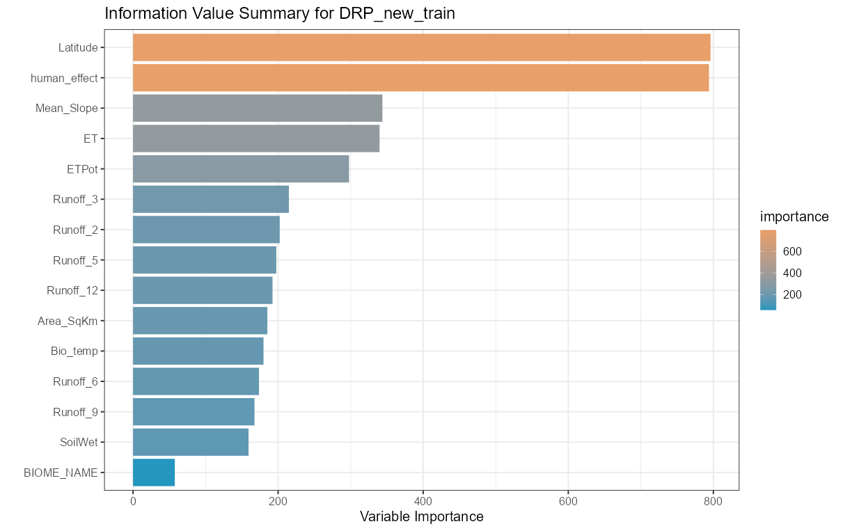
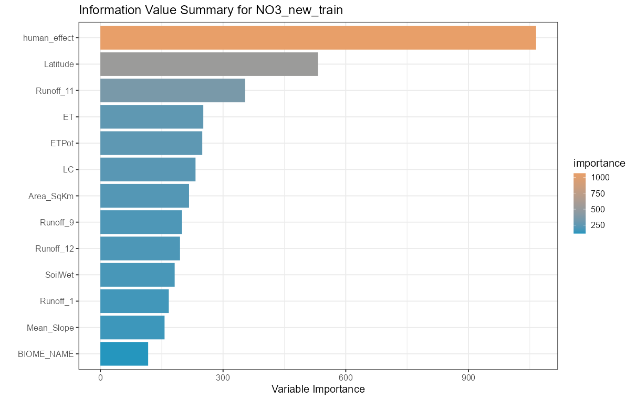
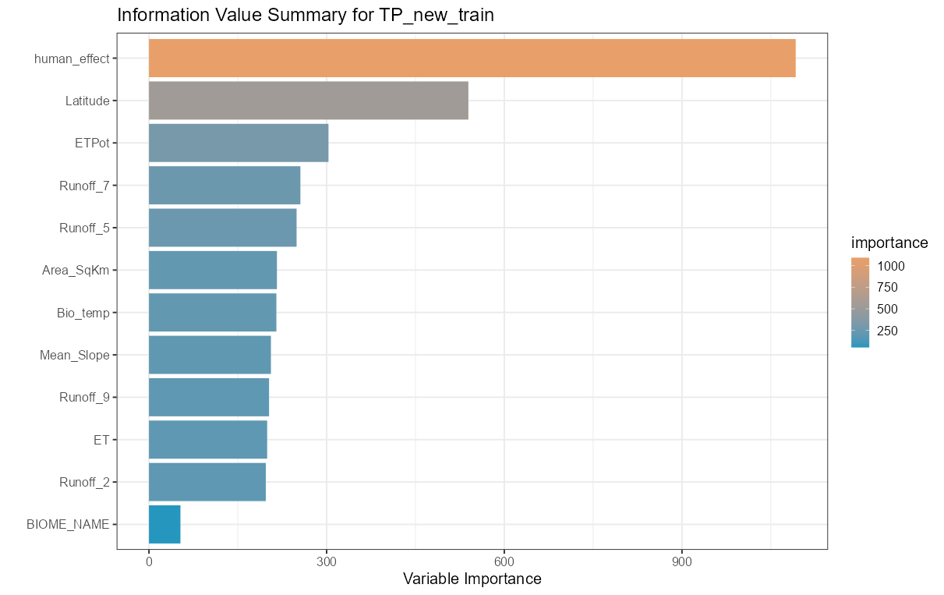
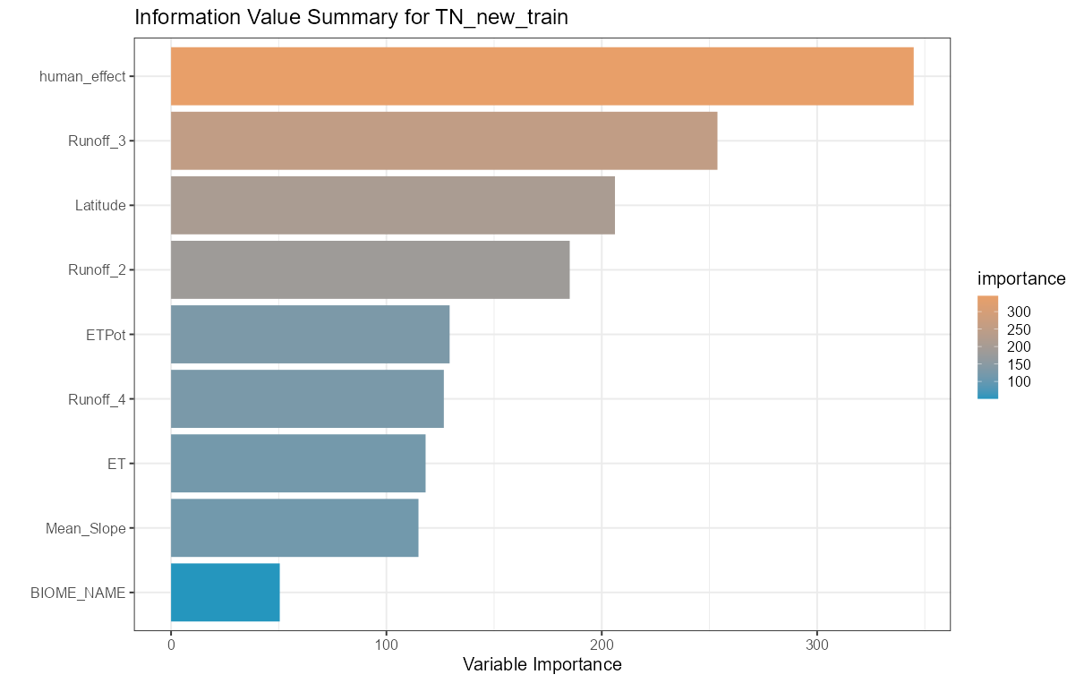
DRP
NO3 -N
TP
TN

Slide 18
Model in python
Analyte | Dataset | Mean absolute error | Mean square error | R²
DRP | Train | 0.235 | 0.148 | 0.956
 | Test | 0.643 | 0.962 | 0.754
NO₃-N | Train | 0.260 | 0.126 | 0.945
 | Test | 0.737 | 0.992 | 0.568
TP | Train | 0.259 | 0.133 | 0.944
 | Test | 0.741 | 1.043 | 0.607
TN | Train | 0.249 | 0.141 | 0.931
 | Test | 0.598 | 0.815 | 0.602
The Python code is available in Figshare (https://figshare.com/s/b51c203d572026b7ee28).

Slide 19
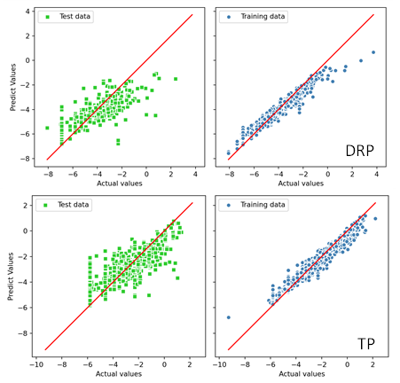
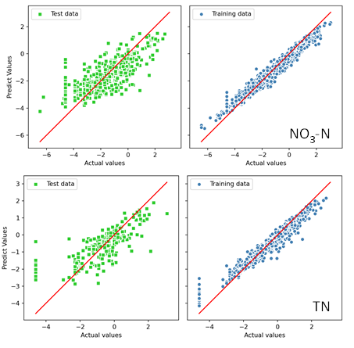

Slide 20
Notes:
Since the Partial and Accumulated profiles are parallel to each other, they suggest that the model is additive for Human Effect and other explanatory variables.
The Conditional profile are steeper than the Partial profiles. This indicates the effect of Human Effect includes the effect of other correlated variables.

Slide 21
Modelling result
Area | Nitrate-nitrogen | Total nitrogen | Dissolved reactive phosphorus | Total phosphorus
Africa | 0.20 | 0.40 | 0.25 | 0.10
Asia | 0.21 | 0.35 | 0.24 | 0.09
Europe | 0.56 | 0.86 | 0.48 | 0.20
North America | 0.15 | 0.30 | 0.14 | 0.06
Oceania | 0.03 | 0.09 | 0.05 | 0.02
South America | 0.11 | 0.21 | 0.10 | 0.07
World | 0.21 | 0.37 | 0.21 | 0.09
Notes:
Mean proportion of continental and global enrichment (compared to reference conditions)
and is higher than the global mean because we monitor in catchments with more intensive ag than most countries.

Slide 22
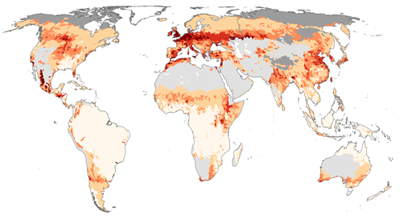
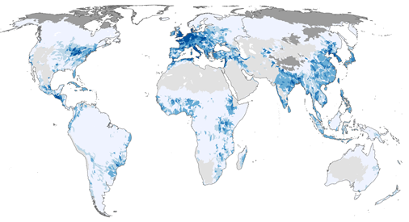
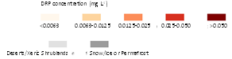
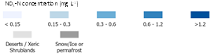
Current

Slide 23
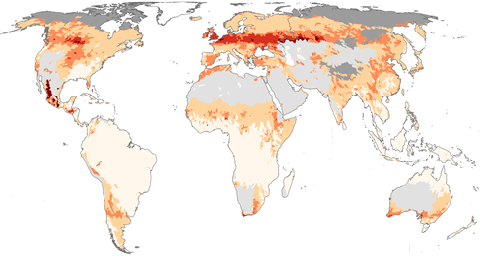
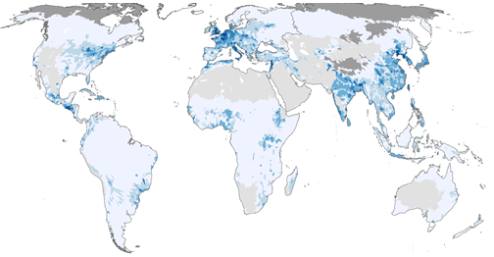
Reference

Slide 24
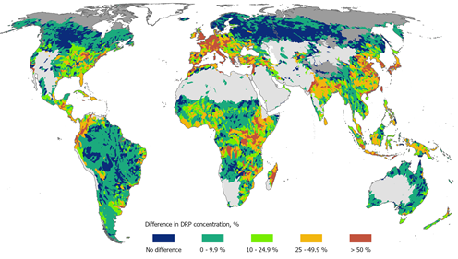
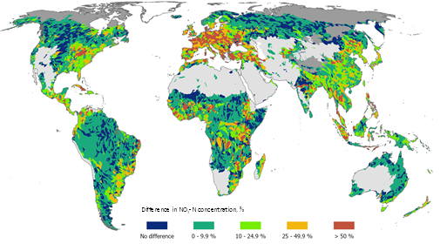
Enrichment

Slide 25
summary
Drawing from global databases and journal articles, we utilized a random forest approach to establish reference concentrations for water quality contaminants. This study seeks deeper understanding of human influences on nutrient losses. The ultimate goal is to provide information for policies that correct human impacts and promote global water quality improvements.

Slide 26
Reference
1 Scarsbrook, M. R., McBride, C. G., McBride, G. B. & Bryers, G. G. Effects of climate variability on rivers: Consequences for long term water quality analysis. JAWRA Journal of the American Water Resources Association 39, 1435-1447 (2003).
2 Larned, S. T., Snelder, T., Unwin, M. J. & McBride, G. B. Water quality in New Zealand rivers: current state and trends. N. Z. J. Mar. Freshwat. Res. 50, 1-29 (2016).
3 McDowell, R. W., Noble, A., Pletnyakov, P. & Mosley, L. M. Global database of diffuse riverine nitrogen and phosphorus loads and yields. Geoscience Data Journal 8, 132-143 (2021).
4 McDowell, R. W., Noble, A., Pletnyakov, P., Haggard, B. E. & Mosley, L. M. Global mapping of freshwater nutrient enrichment and periphyton growth potential. Scientific Reports 10, 3568 (2020).

Slide 27
Reference
5 Federal Institute of Hydrology. Global River Data Centre, <https://www.bafg.de/GRDC/EN/01_GRDC/grdc_node.html> (2018).
6 Lehner, B. HydroBASINS. 9 (McGill University, Montreal, Quebec, Canada, 2014).
7 Lim, K. J. et al. Automated web GIS based hydrograph analysis tool, WHAT1. JAWRA Journal of the American Water Resources Association 41, 1407-1416 (2005).
8 Francoeur, S. N., Biggs, B. J. F., Smith, R. A. & Lowe, R. L. Nutrient limitation of algal biomass accrual in streams: seasonal patterns and a comparison of methods. J. N. Am. Benthol. Soc. 18, 242-260 (1999).
9 Julian, J. P., de Beurs, K. M., Owsley, B., Davies-Colley, R. J. & Ausseil, A. G. E. River water quality changes in New Zealand over 26 years: response to land use intensity. Hydrol. Earth Syst. Sci. 21, 1149-1171 (2017).

Slide 28
Reference
10 Álvarez, X., Valero, E., Santos, R. M. B., Varandas, S. G. P., Sanches Fernandes, L. F. & Pacheco, F. A. L. human nutrients and eutrophication in multiple land use watersheds: Best management practices and policies for the protection of water resources. Land Use Policy 69, 1-11 (2017).
11 Dodds, W. K. & Oakes, R. M. A technique for establishing reference nutrient concentrations across watersheds affected by humans. Limnol. Oceanogr. Methods 2, 333-341 (2004).
12 McDowell, R. W., Snelder, T. H., Cox, N., Booker, D. J. & Wilcock, R. J. Establishment of reference or baseline conditions of chemical indicators in New Zealand streams and rivers relative to present conditions. Mar. Freshwat. Res. 64, 387-400 (2013).
13 Abdi, H. Partial least squares regression and projection on latent structure regression (PLS Regression). Wiley Interdisciplinary Reviews: Computational Statistics 2, 97-106 (2010).

Slide 29
Reference
14 Cutler, D. R. et al. Random forests for classification in ecology. Ecology 88, 2783-2792 (2007).
15 Hou, E., Tan, X., Heenan, M. & Wen, D. A global dataset of plant available and unavailable phosphorus in natural soils derived by Hedley method. Scientific Data 5, 180166 (2018).
16 Obu, J. et al. Northern Hemisphere permafrost map based on TTOP modelling for 2000–2016 at 1 km2 scale. Earth-Sci. Rev. 193, 299-316 (2019).

Slide 30
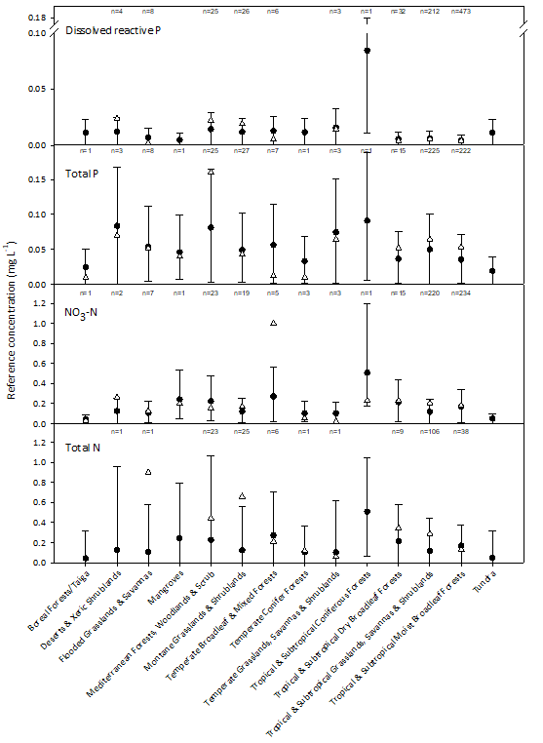
Modelling result

